Slide 1
The REGATRACE project
Stefano Proietti, ISINNOVA
Warsaw,
22 June 2022
This project receives funding from the European Union’s Horizon 2020 Framework Programme Research and Innovation under Grant Agreement no. 857796

Slide 2
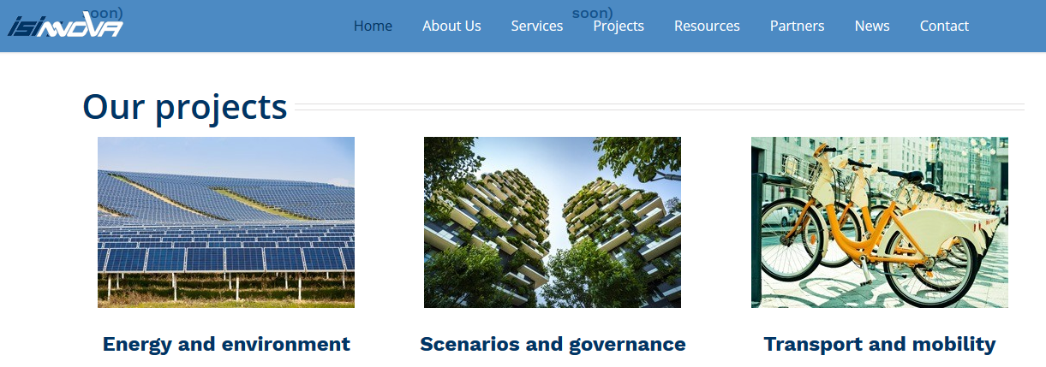
Who we are
Research and consultant Institute founded in 1971
Consolidated experience in energy efficiency, sustainable mobility, territorial systems, environmental sustainability
15 members staff with multidisciplinary background in engineering, statistics, economics, politics and informatics
Long story of collaboration at national (Ministries, Regions, Provinces and Municipalities) and international level (European Commission, World Bank, European Bank of Investments, foreigner Ministries, Regions e Municipalities, etc.)
Specialised skills in coordination of projects, analysis of and support to policies, impact assessment, evaluation of policies and technologies energy efficiency, monitoring of participation processes to policies.
www.isinnova.oorg
REGATRACE workshop, 22 June 2022 Page 2

Slide 3
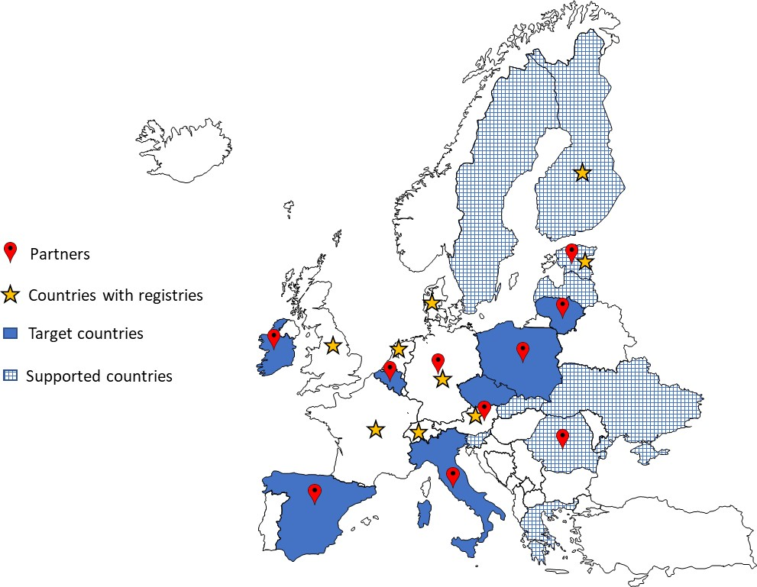
Project Summary
REGATRACE: REnewable GAs TRAde Centre in Europe (HORIZON 2020);
42 months (June 2019- November 2022);
16 partners in 11 countries: ISINNOVA, CIB (IT), EBA, AIB, ERGaR, Fluxys (BE), RFGI (IE), DENA, DBFZ (DE), AGCS (AT), Elering (EE), UPEBI (PL), ARBIO (RO), NEDGIA (ES), Amber (LT), CzBA (CZ), ARBIO (RO)
10 EBA Linked Third Parties + 5 ERGaR Linked Third Parties
3.000.485,00 € of EC funding (100%);
The aim is to create an efficient system based on issuing and trading biomethane/renewable gases certificates (including GoO and PoS) and to support market development (with several guidelines, participatory workshops, etc.);
Activities:
European biomethane/renewable gases GoO and certification system
Set-up of national GoO issuing bodies
Integration of GoO from different renewable gas technologies with electric and hydrogen GoO systems
Integrated assessment and sustainable feedstock mobilisation strategies
Support for biomethane market uptake
Transferability of results beyond the project countries
Dissemination & Communication.
REGATRACE workshop, 22 June 2022 Page 3

Slide 4
European biomethane/renewable gases GoO and certification system
Establish the network of the national issuing bodies
Establish communication interfaces between the hub and the participating national GoO issuing bodies
Establish communication dashboard for system users
Definition of tender procedure for the supply of hub and trading platform IT-services
REGATRACE workshop, 22 June 2022 Page 4

Slide 5
Set-up of national GoO issuing bodies
Guidelines for establishing national biomethane registries
Set-up of national/regional biomethane registries in the target countries (7 ones).
REGATRACE workshop, 22 June 2022 Page 5

Slide 6
Integration of GoO from different renewable gas technologies with electric and hydrogen GoO systems
Analysis of GoO from different renewable gas technologies and development of verification standards
Comparison of the ERGaR system for biomethane/renewable gas GoO and the AIB system for electricity GoO
Coordination between the electricity and the biomethane/renewable gas and hydrogen certification (GoO) systems
REGATRACE workshop, 22 June 2022 Page 6

Slide 7
Integrated assessment and sustainable feedstock mobilisation strategies
Assessment of quantitative potential of promising and competitive production capacities for renewable gases in the different countries of the project
Mobilisation of waste and residue streams and identification of hot-spot regions
Guidelines on renewable gas sustainability certification
REGATRACE workshop, 22 June 2022 Page 7

Slide 8
Support for biomethane market uptake
Mapping on the state of play of renewable gases market in Europe (23 countries)
National strategic visions and roadmaps (with 4 participatory workshops in 14 countries)
Guidance for feasibility analysis (also applied in 6 countries, i.e., BE, CZ, ES, IE, IT, and PL) and guidebook on securing financing for biomethane investments
REGATRACE workshop, 22 June 2022 Page 8

Slide 9
Transferability of results beyond the project’s countries
Proper exploitation and transferability of project results through the organisation of five workshops in non-partner countries (in CY, HU, NO, PT, and RS).
These workshops represent, through the involvement of the main local/national stakeholders, the opportunity to consolidate and exchange the concepts and outputs developed by the project (e.g., on registries, GoO, REGATRACE trading system, Power-to-Methane sustainability etc.), with the aim to trigger a replication effect outside it.
REGATRACE workshop, 22 June 2022 Page 9

Slide 10
What done so far
Guidelines for the European Biomethane GoO and to set-up national biomethane registries
Mapping on the state of play of renewable gases market in Europe
MoU among national issuing bodies to set-up the network of issuing bodies
Guidelines for tender process of IT-services
Investigative study of IT system options for harmonized European cross border title-transfer of biomethane/renewable gas certificates
Guidelines for the verification of cross-sectoral concepts
Harmonised set of rules for the conversion of electricity into biomethane/renewable gas and hydrogen GOs
Guidebook on securing financing for biomethane investments
National strategic visions and roadmaps
Guidelines on renewable gas sustainability certification
REGATRACE workshop, 22 June 2022 Page 10

Slide 11
Support for national strategic visions and roadmaps
Shared strategic visions and roadmaps in “target” countries (BE, ES, IE, IT, LT, PL and CZ) and in “supported” ones (EL, EE, FI, LV, UA and SI)
Participatory process with 4 “operational” workshops in each country (involving several national stakeholders):
The first one to present the REGATRACE project and the mapping to fill eventual gaps and to collect inputs for the elaboration of the long-term strategic vision;
The second one to present the draft strategic long-term vision to discuss and to consolidate it through inputs from stakeholders and to collect ideas and inputs to elaborate the national roadmap;
The third one to present and consolidate a national roadmap, with a list of concrete actions and to present the draft guidance for feasibility analysis;
The fourth one to present the final country tailored guidance for feasibility analysis.
REGATRACE workshop, 22 June 2022 Page 11

Slide 12
Agenda of the workshop
Time | Topic | Moderator
08:30 -09:00 | Welcome coffee
09:00 -09:10 | Welcome & Introduction to Workshop | Magdalena Rogulska (UPEBI) | Magdalena Rogulska (UPEBI)
09:10 -09:20 | The REGATRACE project | Stefano Proietti (ISINNOVA) | Stefano Proietti (ISINNOVA)
09:20 -09:40 | The European Commission's Biomethane Action Plan | Anthony Lorin (EBA) | Anthony Lorin (EBA)
09:40 -10:00 | What is happening with the European GO standard for gases, including biomethane? | Katrien Verwimp (AIB) | Katrien Verwimp (AIB)
10:00 -10:20 | ERGaR Schemes for cross-border biomethane trade and the role of the network of the registries | Matthias Edel/Katharina Kramer (ERGaR) | Matthias Edel/Katharina Kramer (ERGaR)
10:20 -10:40 | Challenges for a European certificate system for renewable gas on the practical example of Austria | Katrien Verwimp (AIB) | Stefanie Königsberger/ Andreas Wolf (AGCS)
10:40 -11:00 | How biomethane can be included in the ETS and non-ETS? |  | Katharina Sailer/Klaus Völler (DENA)
11.00 -11:30 | Coffee break
11:30 -11:50 | Renewable gases developments in Poland | Dirk Focroul (Fluxys) | Sylwia Koch-Kopyszko/ Magdalena Rogulska (UPEBI)
11:50 -12:10 | Biomethane in transport in Poland | Tomas Velghe (VEKA) | Izabela Samson-Bręk (IOŚ)
12:10 -12:30 | Q&A
12:30 -13:00 | Conclusions & next steps
13:00 -14:00 | Lunch
REGATRACE workshop, 22 June 2022 Page 12

Slide 13
Thanks for your attention!
Stefano Proietti, Loriana Paolucci
ISINNOVA
Contact details
sproietti@isinnova.org
lpaolucci@isinnova.org
www.regatrace.eu
www.isinnova.org
This project receives funding from the European Union’s Horizon 2020 Framework Programme Research and Innovation under Grant Agreement no. 857796

