Slide 1
ERGaR Schemes for Cross-Border Biomethane Trade
Matthias Edel (ERGaR)
Target Workshop for the set-up of registries and integration into the European network, 22 June 2022, Warsaw

Slide 2
About ERGaR
International non-profit, non-governmental organisation (BE law) established in September 2016
Founded by established biomethane registries
ERGaR provides a forum for the collaboration of renewable gas registries and market participants in Europe
33 ERGaR members in 13 European Countries
Established biomethane / renewable gas registries, appointed issuing bodies
Traders
Gas DSOs & TSOs
Biogas associations
Other major stakeholders of the European biomethane market

Slide 3
ERGaR Schemes
Under discussion with DG ENER

Slide 4
ERGaR CoO Scheme
Scheme Operator
The Operator of the Scheme is ERGaR aisbl.
ExtraVert Platform
central, stand-alone IT-system enabling European certificate exchanges.
IT-provider: development, operation and maintenance by Vertogas B.V. under the authority of ERGaR aisbl
Admission process
There is no precondition that the National Registry must be an ERGaR member.
Any registry which wishes to become System Participant has to successfully undergo the admission process, including
assessment of application forms,
completion of interface tests,
vote by the ERGaR Executive Board.

Slide 5
Scope and Certificates
Certificate of Origin (CoO)
Electronic document recording information about injected biomethane into the Natural Gas Network
Can be used by gas consumer to demonstrate use of a biomethane consignment against an energy amount of gas that the consumer has withdrawn from the Natural Gas Network
CoOs follow the approach detailed in Article 15 of Directive (EU) 2009/28 and Article 19 of Directive (EU) 2018/2001 (RED II)
an adaptation to the revised CEN Standard 16325 is planned
Proof of Sustainability (PoS)
PoS can be incorporated as attribute and attached to the transfer.
Biomass codes
Different biomass coding schemes are supported by the ERGaR Scheme.
Mass Balancing
Possible, detailed rules currently being prepared by ERGaR to meet the mass balancing requirements of the IA on Voluntary Schemes and Sustainability Verification

Slide 6
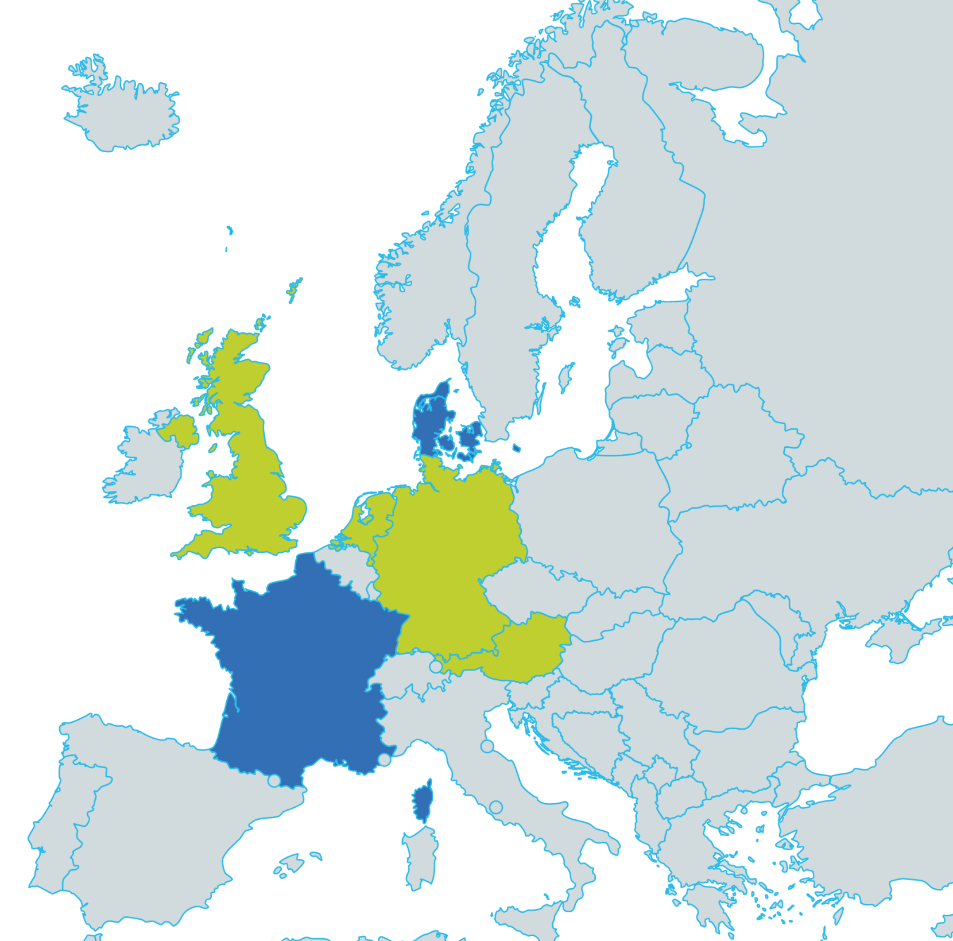
System Participants
System Participants:
AGCS (AT)
Dena (DE)
GGCS (UK)
Vertogas (NL) issuing body with government mandate
In the process of joining the CoO Scheme:
Energinet (DK) issuing body with government mandate
GRdF (FR) (subject to governmental decision expected for 2023)
Other issuing bodies showed interest in joining the ERGaR CoO Scheme and will be able to prepare their applications when their IT-systems will have been established.
Market Coverage:
Currently, ERGaR CoO System Participant countries make up approx. 2/3 of total biomethane production in Europe. If France and Denmark join, this will grow to more than 80%.

Slide 7
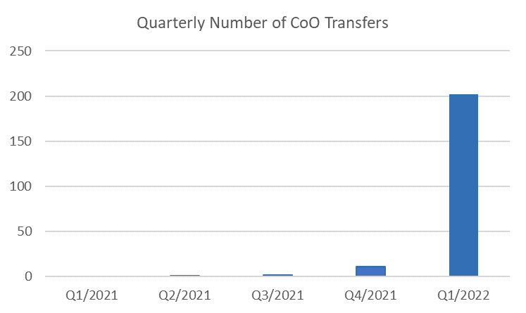
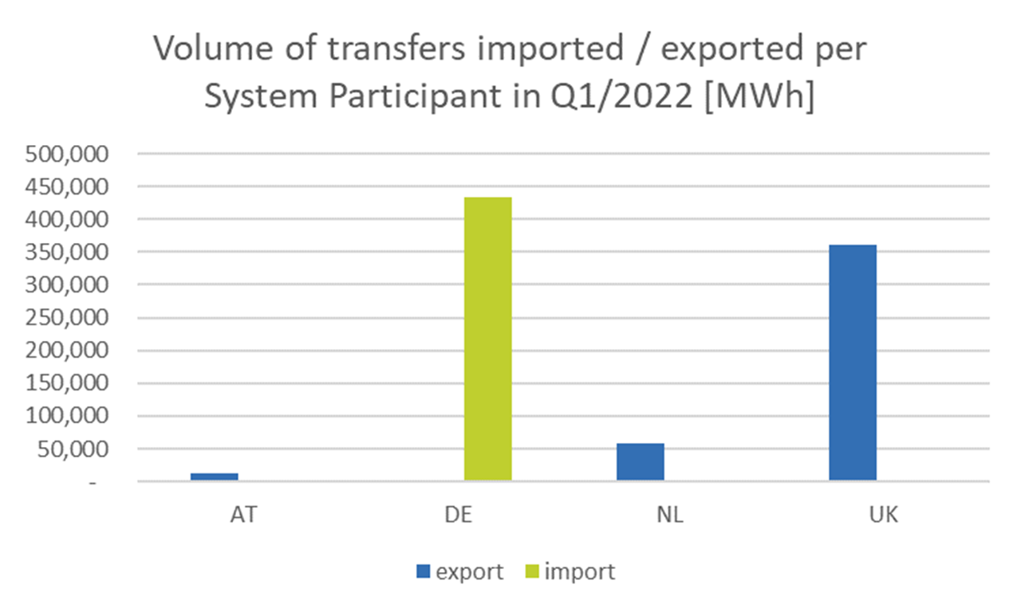
Statistics
The number of transaction is continuously increasing.
202 biomethane CoO were transferred in Q1/2022. The corresponding volume was 433 GWh.
In Q1 2022, the dena Biogasregister received all transfers.
All transfers followed the book&claim principle. However, ERGaR members expect an increasing demand for the documentation of transfers following the mass balancing principles.

Slide 8
Outlook
The process of establishing issuing bodies is ongoing and more System Participants are expected to join ERGaR CoO Scheme in the future.
The revision process of CEN standard 16325 is ongoing. Adaptions will become necessary for the ERGaR CoO Scheme and the System Participants´ IT.
A final concept for the documentation of sustainable renewable gas consignments with the Union Database has not been presented, yet. The potential impact on the documentation and tracing of renewable gas certificates, which are linked to Proofs of Sustainability (PoS), remains unclear.
The linking of GOs and PoS requires a framework for the cooperation between competent authorities on national, e.g. issung bodies, and international level, e.g. voluntary schemes.
ERGaR and AIB are exploring possibilities for integration / linking of their EECS and ERGaR Schemes.

Slide 9
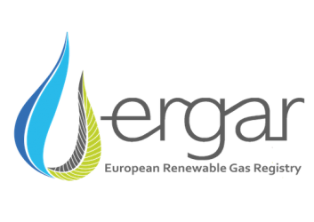
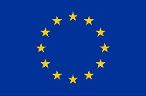
Thanks for your attention!
European Renewable Gas Registry aisbl (ERGaR)
Matthias Edel, edel@ergar.org
This project receives funding from the European Union’s Horizon 2020 Framework Programme Research and Innovation under Grant Agreement no. 857796

