Slide 1
AIB and EECS (European Energy Certificate System)
17/6/2022
Katrien Verwimp
Coordinator Sector Integration – Energy Certificates

Slide 2
The Association of Issuing Bodies (AIB) operating EECS
01

Slide 3
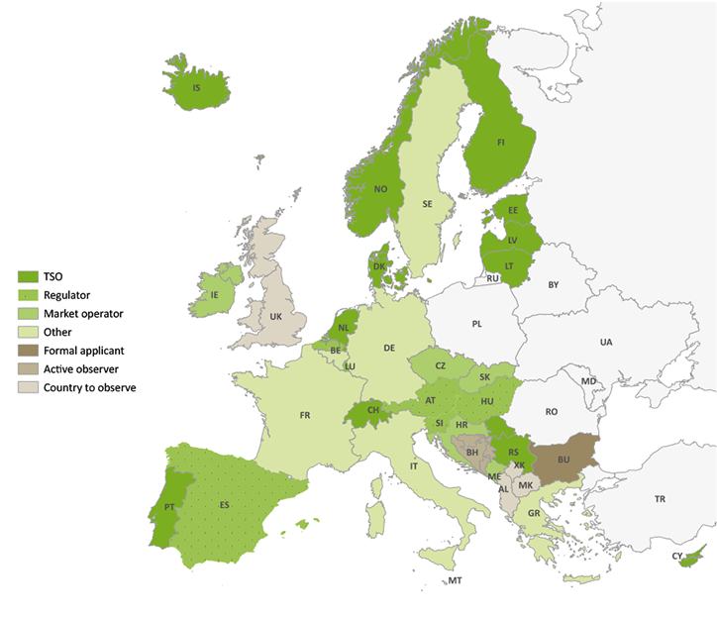
AIB
The Association of Issuing Bodies - Facts
AIB Mission: Guaranteeing the origin of European Energy
AIB: non-profit association founded in 2002
Now 28 countries connected (33 members)
Geographical scope: EU - EFTA – Energy Community
Issuing Bodies have diverse roles: regulator, market operator, TSO, ministry, power exchange etc.
All AIB’s current members are issuing bodies for electricity GOs
About half AIB’s members are also competent bodies for the supervision of electricity disclosure
10 AIB members assigned by their government for issuing GOs for gases – more to follow
Austria (E-Control), Belgium Brussels (Brugel), Belgium Flanders (VREG), Belgium Wallonia (SPW), Estonia (Elering), Finland (Gasgrid Finland), Italy (GSE), Lithuania (Amber Grid), Portugal (REN), Switzerland (Pronovo)
Developer and custodian of the EECS© standard
Pillars of the European Energy Certificate System (EECS©)
EECS Rules: engaging into quality and harmonisation
IT hub: enables GO transfer between national/regional Domain registries
Peer reviews and audits
www.aib-net.org

Slide 4
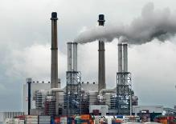
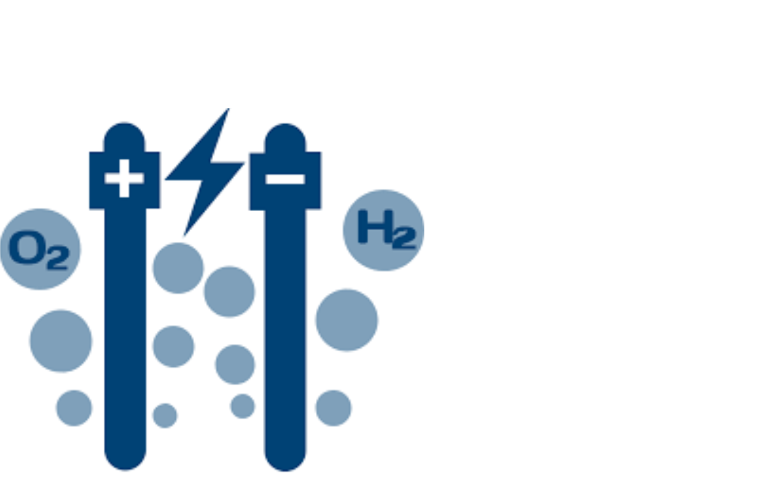
Book and Claim Certificate System
Supply
Demand
Gas Market
Physical gas market
Enables consumer choice
Promotes market efficiency and simplicity
Protects liquidity
Supports the internal market
GO market
GO Registry
GO System
Issuing
Cancellation
Producer Account
Trader Account
Supplier/Consumer Account

Slide 5
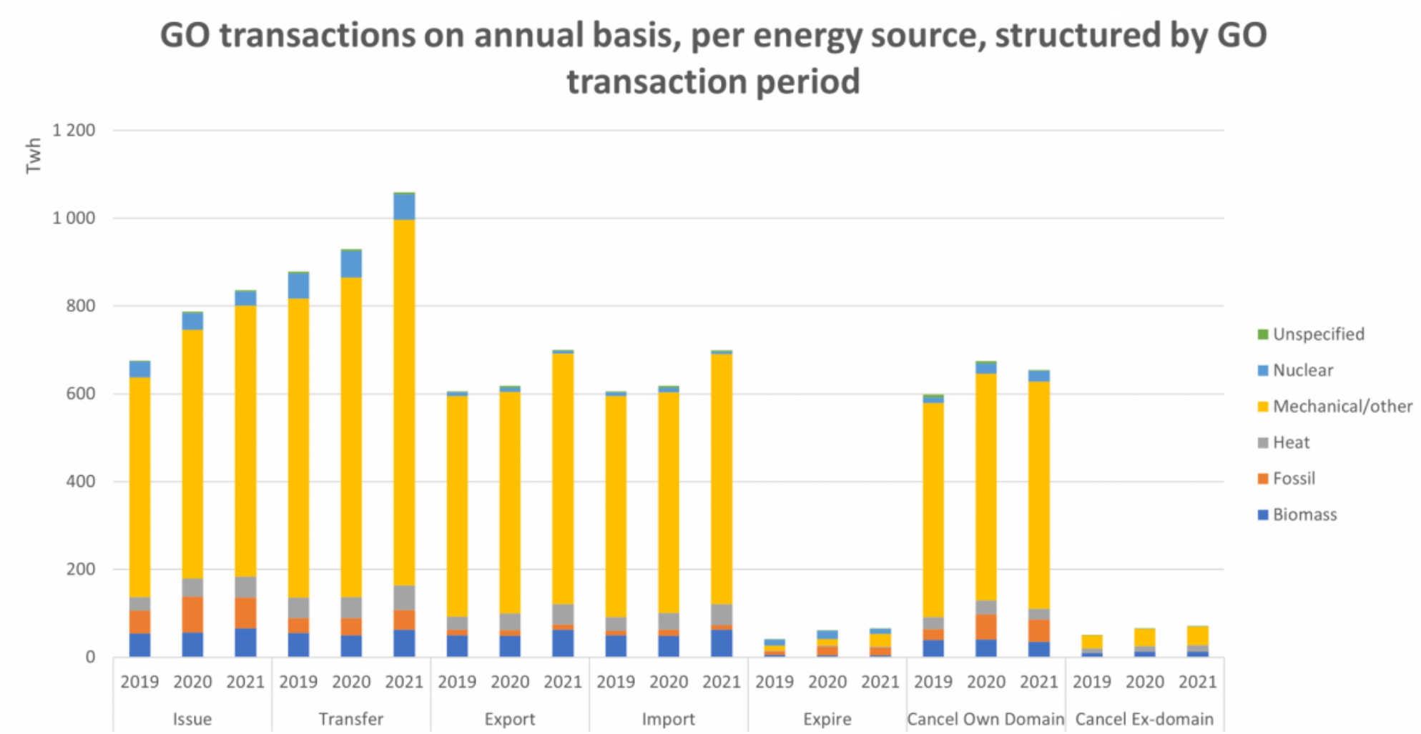
The AIB HUB
Domain A - Registry
Framework
GO
Trader Account
International transfers of electronic documents
2021: 700 million GOs cross border transfer
27 Domains
How
Standardised
Automated
Jointly operated
Why
Efficiency
Trust
Fraud prevention
Producer Account
Supplier/consumer Account
Domain B – Registry
Domain C -
Registry
The HUB
Trader Account
Trader Account
Domain D – Registry
Supplier/consumer Account

Slide 6
AIB organised to facilitate multi-energy
General Meeting
AIB Hub facilitates cross-registry transfer of gas certificates in Q4 2022.
EECS Energy Carrier Conversion Rules
Since September 2019
Gas issuing bodies will be enabled to import electricity GOs, Electricity issuing bodies (31) will be enabled to import gas GOs. Issuing EECS Gas GOs requires membership to EECS Gas Scheme Group.
Separate decision making for Electricity and Gas specifics
Since February 2020
Electricity Scheme Group
Electricity Scheme = section N of the EECS Rules
Voting members
Gas Scheme Group
Existing members
Observer - Scheme co-developer status
Forum for discussion and resolution of challenges
EECS Gas Scheme: Chapter O of the EECS Rules (since nov 2019)
Board
EECS ELECTRICITY
SCHEME GROUP
EECS GAS
SCHEME GROUP
EECS Unit
External Affairs Unit
Information Systems Unit
Disclosure Platform

Slide 7
The Guarantee of Origin as an EECS Product
02

Slide 8
What does a Certificate look like under EECS™?
Generic EECS Certificates
Additional on Electricity Certificate
Additional on Gas certificate
(= Energy Gas / Hydrogen)
Energy Carrier
Product
Unique certificate number
Production period (start and end dates)
Type of installation
Production device info
Identity and country of relevant competent body
Purpose
Label(s) *
Identity and country of originating member
Issue date
Energy source
Support received by type
Electricity / Energy Gas / Hydrogen
Disclosure, Support and/or Target
Dissemination level
GO / Support Certificate / Target Certificate / Independent Criteria Scheme
Product name
Timestamp *
Production Device Module *
Carbon Footprint *
Radioactive waste *
Face Value
Conversion Tag & Storage Tag
High-Efficiency Cogeneration
High Efficiency Cogeneration Criterion Met?
Lower Calorific Value
Y/N
Use of Heat
Primary Energy Savings
CO2 Emissions
% PES
If Yes, then also following fields are mandatory
Absolute PES
%
Absolute
Type of Gas
Whether Higher or Lower Calorific Value
See Fact Sheet
GHG Emissions Saved & Produced *
Sustainability Criteria met?*
GHG saving criteria met?*
End-Use of gas category*
Y/N; requirements, scheme, name Certification Body, reference to report
+ Methodology reference
Calorific value *
Source-Shares *
Production Device Module(s) *
Pre-Conversion support info *
PurityOfGas *
CompositionCriteriaReference *
Advanced Biofuel Criteria Met? *
Description, capacity, date operational
Fossil energy sources
CO2 Emissions
Nuclear energy sources
Radioactive Waste
Legend:
Mandatory information field
*Optional information field

Slide 9
European Legislation
Guarantees of Origin
Renewable Energy Directive
2018/2001 (EU) Art. 19
Guarantee of Origin
Internal Energy Market Directive 2019/944 (EU) Annex 1.5
Draft Gas Directive Annex 1.5
Electricity / Gas Disclosure
€

Slide 10
Framework for cross border harmonisation of guarantees of origin
3. Efficient and reliable GO system - voluntary standard -EECS
1. GOs are for disclosure – legislation - REDII
2. Reliable GO system – mandatory standard – EN16325
EN16325
REDII
EECS
EN 16325
EECS
Note: EECS covers also other products than guarantees of origin

Slide 11
The European Energy Certificate System (EECS)
Framework
EECS Rules
Core principles – objectives & aspirations
Plant registration
EECS participation rules
Membership, admission, compliance, disputes & change
Scheme specific rules
Detail
“subsidiary documents”
Decision-making – disputes, voting etc
Registry system & networking standards
Approval of agents
Change management
Assignment of codes
Audit & periodic reviews
Dynamic information
“fact sheets”
Addresses, membership details, codes, guidelines ...
Domain protocols
Certificate issue, transfer and cancellation
E.g., electricity, gas ...
Description of regulations in a specific country
Certificate Administration
Mirrored in EN16325, based on EECS

Slide 12
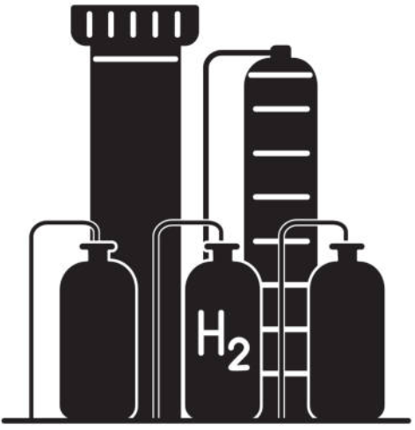
Why a generic GO system for all energy carriers?
GO Conversion Issuance
GO system
Hydrocarbon network-compatible gas
GO system
Hydrogen
GO system
Electricity
GO system
Hydrogen

Slide 13
Certificate Product Types under the EECS standard
EECS CERTIFICATES
GO
Support Certificates
ICS Certificate
NGC EECS Disclosure
Target Certificate*
EECS GO
NGC CertifHy
PRODUCT Type
Source
Technology
PRODUCT Name
Abbreviations
GO = Guarantee of Origin
ICS = Independent Criteria Scheme
NGC = Non-Governmental Certificate
LC = Legislative Certificate
EECS = European Energy Certificate System
Purpose
Disclosure
Support
Target Accounting
* For any Target Certificate Product, the corresponding Target Accounting Scheme acknowledges that the eligibility for Target accounting is transferred together with the corresponding Target certificate.

Slide 14
The relation between EECS Certificate types and labels
EECS CERTIFICATES
GO
Support Certificates
ICS Certificate
NGC EECS Disclosure
Target Certificate
NGC CertifHY
EECS GO
LC DK Granular
PRODUCT TYPE
Source
Technology
PRODUCT NAME
Label
EKOENERGY
Better Biomass (NTA8080)
CertifHy Low Carbon
TüvSüd
CertifHy Renewable
LABELS
ICS
Abbreviations
GO = Guarantee of Origin
ICS = Independent Criteria Scheme
NGC = Non-Governmental Certificate
LC = Legislative Certificate
EECS = European Energy Certificate System

Slide 15
Relation with Independent Criteria Schemes
03

Slide 16
Independent Criteria Schemes as EECS Products
Categories of ICSs
Operator
AIB
External Scheme operator
Legal status
Non-Governmental Certificate
Legislative Certificate

Slide 17
Independent Criteria Scheme: agreement between ICS operator and AIB
EECS Rules Section D ‘EECS Products’
D2.4 ICS Certificates
D2.4.1 For a type of ICS Certificate to be accepted as an EECS Product:
the type of ICS Certificate must relate either to:
the energy source for the associated Output;
the technology used in producing the associated Output;
the Scheme Operator of the relevant ICS Scheme must have entered into an agreement with the AIB regarding the operation of that ICS Scheme.
Independent Criteria Schemes may only be added to or removed from the Fact Sheet “Independent Criteria Schemes” by the General Secretary and with the support of the relevant Scheme Group.
Clear Scope
Shared Geographical Scope
EECS Compliance
Not competing with GO schemes and other legislative schemes
Clear authorisation and compliance criteria for issuing bodies under the ICS Scheme
Framework description for Scheme Update and Maintenance
Legal entity operating the Scheme
Clear Exit Conditions
Criteria for the agreement between AIB and ICS operator
Note: Issuing Bodies using the AIB Hub for cross-registry transfer shall comply with the EECS Rules.

Slide 18
Guarantees of Origin
Expand
Guard
Develop

Slide 19
Let’s together continue to strengthen energy tracking!
www.aib-net.org
+32 (0)486 55 83 01
info@aib-net.org

