Slide 1
Stakeholder Workshop Poland Challenges for a European certificate system for renewable gas on the practical example of Austria

Slide 2
Our services to the Austrian gas market
Tasks of AGCS Gas Clearing & Settlement AG
Balancing Group Coordinator
Clearing of the Austrian gas market
Organisation of the imbalancing energy market in Austria
Calculation and settlement of imbalancing energy
MERIT Order List platforms
Supplier Switching Platform in Austria ENERGYlink
Tracking of all gas movements and injections in Austria
incl. biomethane, renewable gases
Basis of our work
Austrian Gas Economy Act (GWG 2011)
Terms and Conditions
Renewable Electricity Act (ÖSG 2012)
AGCS Biomethan Register Austria
Renewables Expansion Act (EAG 2021)
Data exchange between established registries

Slide 3
Challenges for a European certificate system for renewable gas
Integration into European Energy Market
1
Legal Framework
2
Certification and Sustainability
3
Competences and Responsibility
4

Slide 4
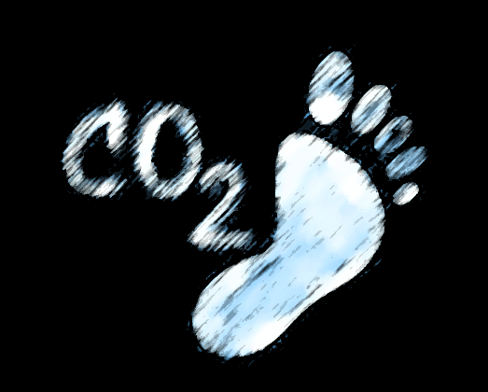
Application purposes (end uses) of renewable gases
Target Compliance
Disclosure
Subsidy Schemes
Market initiatives
Future markets
Union target 32% (Art 3 REDII)
Consumer disclosure
(Art 19 REDII)
No eligibility for target compliance
price premium to be paid by end consumer
Examples
FiT for electrification
Biomethane injection
Tax exemptions
Quotas
Initiatives by society and market
Producers to market the green value of their product
Consumers to increase renewable energy shares
? chemical industry
Transport target 14% (Art 25 REDII)
EU ETS (MRR) Emission Trading System
? Upcoming markets
National targets & quotas
ETS
? EU ETS
Certificate type
Proof of Sustainability (PoS)
Certificate type
Guarantee of Origin (GO)
Certificate type
National certificate
Biomethane certificate
Certificate type
?
Sustainbility claim + MB
Target compliance
No sustainbility claim
No target compliance
Sustainbility claim + MB
Target compliance
?
Notes:
First three applicaiton purposes are legally defined, while other two are based on market initiatives (at least at the moment)

Slide 5
Different application purposes need holistic certificate system
Values
Holistic certificate system
For comprehensive documentation of various application purposes
To avoid potential multiple counting
Values on 3 levels (physical, renewable, sustainabel)
Transferability of values from producer to consumer?
Sustainability claim?
Eligibility for target compliance?
Supply chain Transport / Grid
physical value
Gas
Biomethane Registry
renewable value
certificate, sustainability
Auditor
sustainable value
target compliance
physical value
Provision to all consumers
On-grid: supply chain incl. grids
Off-grid: resp. supply chain
renewable value
Transferability via verification system
Document sustainability & mass balance
sustainable value
Quality criterium „sustainability“
GHG minimum savings
Mass balance
Eligibility for compliance with targets and quotas

Slide 6
Registry: Administer movements of renewable products
Level: physical value
gas flow
GAS GRID
Infrastructure: DSOs, TSOs, gas grid managers, balance group coordinators (BGC)
CONSUMPTION
Application purpose
DSO
& BGC
DSO
& BGC
Injection
Metering Point
Withdrawal
Metering Point
Subsidies
Renewable Power FiT
(ÖSG 2012)
data delivery;
interface
* on-grid: Gaseous fuels along the gas grid
* off-grid: along the respective supply chain
data delivery;
interface
PRODUCTION
Target compliance
Union target (Art 3 RED II)
Fuel quota (Art 25-31 RED II)
Green Gas Quota
* on-grid: linked, along the gas grid
* off-grid: along the respective supply chain
Closing the mass balance
REGISTRY SYSTEM
Biogas plant (anaerobic digestion) with upgrading and grid injection
PRODUCER
Plant operator
CONSUMER
Competent body
Consumer disclosure
Disclose supply mix (Art 19 RED II)
Traceability of the renewable value (quantitative and qualitative properties)
Traceability of green value: sustainability criteria & mass balance
Transparent, secure, trustworthy
Initiatives by society and market
Level: renewable value
certificate & registry
Biomethane
Certificate
Biomethane
Certificate
data delivery
Future markets
AUDITOR
* on-grid: quality criteria
* off-grid: energy amount & quality criteria
For quality criteria „sustainability“: Audit of the whole supply chain & Mass balance
Level: sustainable value quality & sustainability

Slide 7
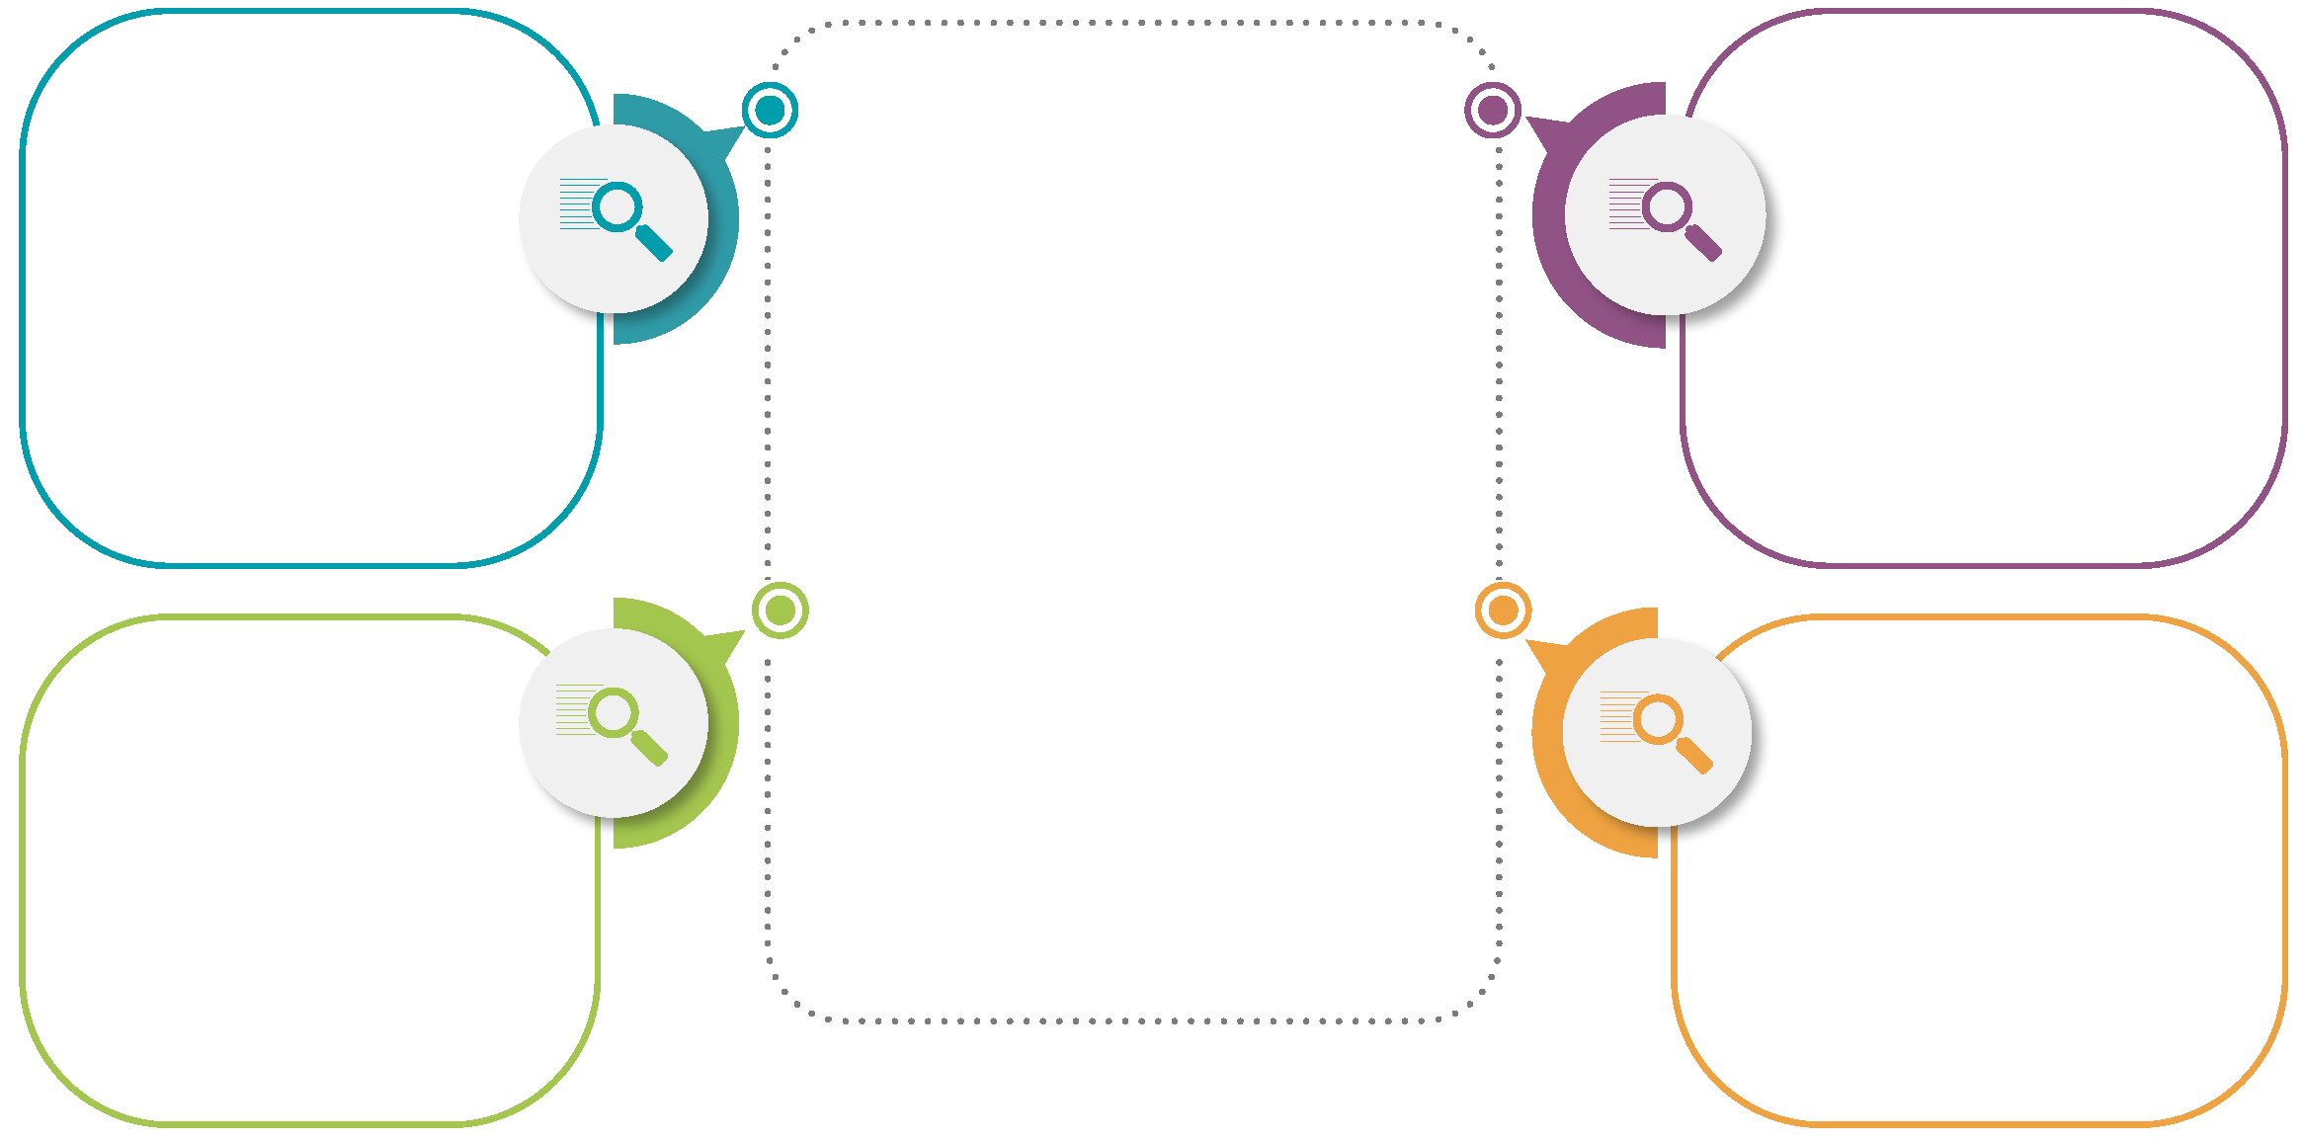
Harmonised Certificate for renewable gas
Audit Level 1
CERTIFICATE
Audit Level 3
Third-party audit
Audit of plant
Initial audit and after construction measures
Regulatory notice for renewable plant
Attributes Level 1
Attributes Level 3
Third-party audit
Regularly (annual)
For specific production period
For specific certificate
According to national regulations
Min: plausibility check
Max: PoS according to voluntary scheme
Plant specific
Static data
Country, metering point, plant type;
Quality criteria
Dynamic data
Qualitative data
Substrates / Input, supply chain, process;
Audit reports: plausibility check <-> sustainability criteria
Attributes
Level 2
Attributes Level 4
Audit Level 2
Transfer specific
NO product data
Enables IT-processes for title transfer
Audit Level 4
Gas specific
Dynamic data
Quantitative data
Energy carrier type
Energy amounts
Basis: metering data
Based on DSO/TSO meter readings
Registry specific: first-level by DSO/TSO, auditors, balance group coordinator;
Regularly: before certificate issuance
Responsibility of market participants
First-level audit: data verification by registries

Slide 8
Challenges for a European certificate system for renewable gas
Integration into European Energy Market
1
Legal Framework
2
Certification and Sustainability
3
Competences and Responsibility
4

Slide 9
Legal Framework for Renewable Gas
Renewable Electricity Act (Ökostromgesetz, ÖSG 2012)
Gas Economy Act (Gaswirtschaftsgesetz, GWG 2011)
Regulation on transport fuels (Kraftstoffverordnung, KVO 2012)
Gas Disclosure Regulation (Gaskennzeichnungsverordnung, G-KenV 2019)
Tax Reform Act (Steuerreformgesetz 2020, SteuerreformG 2020)
Natural Gas Tax Act (Erdgasabgabegesetz 1996)
Renewables Expansion Act (Erneuerbaren Ausbau Gesetz, EAG 2021)
Ecosocial Tax Reform Act PART I (Ökosoziales Steuerreformgesetz 2022 Teil I – ÖkoStRefG 2022 Teil I)
National Emission Certificate Trading Act (Nationales Emissionszertifikate-handelsgesetz, NEHG 2022)
Future Legislation? --> anticipation of Renewable Gas Act? (Erneuerbare Gase Gesetz)
RED: Renewable Energy Directive (EU) 28/2009
FQD: Fuel Quality Directive (EU) 2009/30
RED II: Renewable Energy Directive recast (EU) 2018/2001
MRR: Monitoring and Reporting Regulation (EU) 2003/87

Slide 10
Challenges for a legal Framework for Renewable Gas
Biomethane/Renewable Gas is currently not addressed with a holistic system
Biomethane/Renewable Gas is defined by its application purpose → Producer has to know application purpose already at production to choose suitable audit criteria
Eligibility for target compliance: Union target, Sustainable biofuels for transport, Combustion fuel for EU-ETS
Combustion fuel for consumer disclosure
Different application purposes pose different quality criteria
Disclosure of origin vs Sustainability criteria
Different application purposes require different modes of transfer
Book & Claim (no physical link and thus no target compliance)
Mass balancing (physical link, tracking of whole supply chain, eligibility for target compliance)
Different application purposes pose different time horizons for recognition of certificates
validity period vs eligibility for recognition vs capability for storage
Different application purposes might be documented by different competent bodies
Production/Injection + renewable power FiT: Biomethane Registry Austria + OeMAG
Sustainable biofuels: Biofuel Registry elNa (Environmental Agency)
Gas disclosure: GO Issuing Body (E-Control Austria)
B&C
MB

Slide 11
Challenges for a European certificate system for renewable gas
Integration into European Energy Market
1
Legal Framework
2
Certification and Sustainability
3
Competences and Responsibility
4

Slide 12
Definition Sustainability Criteria
Legal definition of „sustainability criteria“
Art 18 RED I: particularly addressing liquid, sustainable biofuels
(EU) 2009/30 Fuel Quality Directive
Art 25-31 RED II: extension towards renewable gases
sustainability
Cultivation criteria
Mass Balance
Significance in theory and practice
Cultivation criteria Art 29 (2-7) RED II
GHG minimum savings Art 29 (10) RED II
Total GHG emissions along the whole supply chain
Undercutting the respective reference value of the Fossil Fuel Comparator (FFC)
Specific reference values per application purpose published by EC
Total GHG emissions biomethane < GHG emissions FFC reference value
Mass Balance Art 30 (1) RED II
Documentation of the entire supply chain
From substrates via production plant to the end user
Biomethane
<
FFC reference value

Slide 13
Challenge Harmonised auditing
Challenge: Different application purposes pose different quality criteria
Proposed solution approach: Legal anchoring of harmonised auditing criteria for renewable gas
Registry System
AGCS is certified: ISO/IEC 27001 : 2003 & DIN EN ISO 9001 : 2015
MASTER DATA
Registration
Production Plant: Biomethane, electrification
Regulatory notice for renewable plant
Attribute Level 1
Producer has to know application purpose already at production to choose suitable audit criteria
ONE comprehensive and uniform audit enables validity for
Several certificate types
Several application purposes
Target compliance
Auditor
Certificate of competence, certification voluntary scheme
ENERGY
-CARRIER
-AMOUNTS
On-grid
Meter data by grid operators
Attribute Level 2
Off-grid
Meter data by auditors
FiT renewable power (ÖSG 2012)
Auditing reports
QUALITY CRITERIA
Substrates, Technology, Supply Chain
Attribute Level 3
Gas disclosure
(Art 130 GWG 2011, G-KenV)
Confirmation by certification body according to the Accreditation Act 2012
Sustainability, mass balance (Art 25-31 RED II)
Proof of Sustainability EU voluntary scheme
Notes:
Advantages
Simplifies administrative burden for renewable gas producers and auditors
Reduces costs for producers of renewable gases
Legal harmonisation ÖSG 2012 (renewable power FiT), GWG 2011 (gas disclosure), Steuerreformgesetz 2020 (tax), EAG (renewalbes increase), Building regulation, etc

Slide 14
Challenges for a European certificate system for renewable gas
Integration into European Energy Market
1
Legal Framework
2
Certification and Sustainability
3
Competences and Responsibility
4

Slide 15
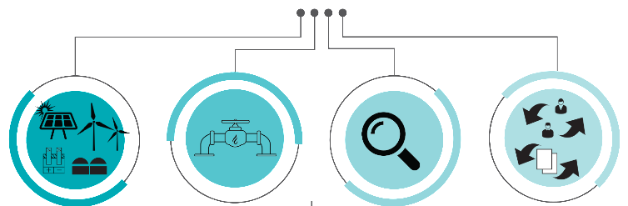
National Challenge interaction of different competent bodies
Data Registry
* incl. mass balancing
Biomethane Certificate
*
INTERFACES
*
National subsidy scheme
(renewable power FiT)
Consumer disclosure
Sustainable biofuels in transport
Initiatives by society and market
New applications (chem. Industry)
New legislative acts
(AT: EAG, SteuerreformG2020)
‘New’ technologies (PtG)
‘New’ energy carriers (Hydrogen, Propane)
Challenges Ahead (covered via versatile CoO and secure Interfaces)
Applications purposes
§
ÖSG 2012; Renewable Electricity Act
RED II Art 19, (AT: Art 130 GWG 2011, G-KenV 2019)
FQD (AT: KVO 2012), RED II (Art 25-30)
voluntary basis
Framework
Competent Body (Application Registry)
Biomethane Registry
Registry for sustainable biofuels
Clearing agency for renewable power
Issuing Body
Biomethane Registry
Types of Evidence Documents
elNa electronic sustainability certification system
Biomethane Certificate
Guarantee of Origin (GO)
Biomethane Certificate

Slide 16
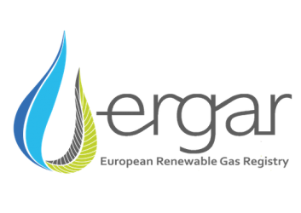
EU Challenge Interaction of different competent bodies
COUNTRY 1
Competent body A
Competent body B
INTERFACES
SCHEMES administration of European data exchanges and ownership transfers
Information and exchange via
?
EU ETS
EU-BIOFUELS
ERGaR European Renewable Gas Registry
ERGaR Schemes
AIB Association of Issuing Bodies
EECS Scheme (European Energy Certificate System)
CertifHy
Consortium of Experts
Certificate system for H2
European Commission
EU 2003/87/EC & 2018/410
Trade of EU-ETS-allowances for ETS-companies
European Commission
Art 28 (2) & 28 (4) RED II (2018/2001)
Responsibility of European Commission
?
INTERFACES
COUNTRY 2
Competent body C
Competent body D

Slide 17
proposed solution approach holistic certificate system
… for a European certificate system for renewable gas
Integration into European Energy Market
acknowledge biomethane as green market pillar
Legal Framework
Certification and Sustainability
harmonisation of cross-sectional legal matter
harmonised auditing procedures
Competences and Responsibility
central clearing agency / cooperation agreements

Slide 18
Thank you for your attention!
Contact AGCS Gas Clearing & Settlement AG www.agcs.at www.biomethanregister.at LinkedIn info@biomethanregister.at
Project Management Stefanie Königsberger: stefanie.koenigsberger@agcs.at Andreas Wolf: andreas.wolf@agcs.at Julian Auderieth: julian.auderiet@agcs.at
REGATRACE Support support-regatrace@agcs.at
This project receives funding from the European Union’s Horizon 2020 Framework Programme Research and Innovation under Grant Agreement no. 857796

