Slide 1
Biomethane in ETS and non-ETS

Slide 2
EU-ETS – European Emissions trading scheme
ETS tracks emissions of CO_{2,} NO₂ and Perfluorcarbone (PFC)
CO₂ from heat and electricity production and energy intense industries most important source
Emitter needs to provide allowance (around 80 - 90€/t or 1.6 €cent/kWh gas)

Slide 3
EU-ETS – European Emissions trading scheme - Biomass
Monitoring and Reporting Regulation - MRR specifies usage of biomass – same definition like RED II
Art. 38 defines usage of biomass as zero emission,
Art. 39 par. 3 allows () GOs for biomethane from the gas grid
Art. 39 par. 4 defines sets the rules for this:
the RED II sustainability requirements are met;
there is no double counting of the same amount of biogas;
the operator and the producer of the biogas are connected to the same gas grid;
the market value of the consumed biomethane was appropriately taken into account in the relevant support program, in case support was granted for biogas production.
Guidance Document No. 3, 5.2 Biogas in natural gas grids
2. Biomass where sustainability criteria apply (currently biofuels and bioliquids
as defined by the MRR):
(a) Criteria are satisfied: Biomass is zero-rated
(b) Criteria are not satisfied: Biomass is treated like a fossil source stream.
3. Biomass where no sustainability criteria apply: Always zero-rated.

Slide 4
EU-ETS – European Emissions trading scheme
Different approaches in different countries
Biomethane GOs not recognized in all countries
Until now, only Germany allows foreign biomethane
GO and (from 2023 on) PoS necessary, mass balanced biomethane only
German Emissions Trading Authority (DEHSt) at the German Environment Agency responsible for implementing European Emission Trading. Foreign biomethane explicitly allowed
in the case of transfer from a foreign register, a retirement document from the supplying system must be submitted and
mass balancing of foreign biomethane quantities must be confirmed by an independent audit.

Slide 5
EU-ETS – European Emissions trading scheme
currently reviewing the extent to which the deductibility of biomethane produced abroad and pre-subsidised can lead to impermissible double subsidisation in the EU ETS. Biomethane from abroad is only deductible under the EU ETS on the condition that an impermissible double subsidy is excluded.
EU-ETS 2 in preparation for 2026 – Scope: mobility and buildings

Slide 6
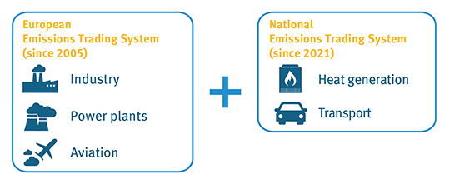
BEHG – national emission trading
DEHSt also responsible for implementing national emissions trading.
Same rules apply to foreign biomethane as in EU-ETS
Sustainability mandatory for all bio-fuels
BEHG all fossil energy carriers
Fixed price path beginning at 25€/tCO2 now to 55 €/tCO2 in 2025, later auctioned
Fuel distributers are obliged to provide certificates
Price range not high enough to support biomethane usage, but makes it cheaper in comparison
Source: German National Emissions Trading Authority, 2022

Slide 7
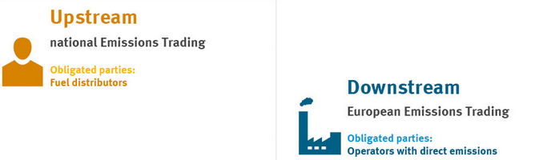
BEHG – national emission trading
BEHG all fossil energy carriers
Fixed price path beginning at 25€/tCO2 now to 55 €/tCO2 in 2025, later auctioned
Fuel distributers are obliged to provide certificates
Price range not high enough to support biomethane usage, but makes it cheaper in comparison
Source: German National Emissions Trading Authority, 2021

Slide 8
Emission Reduction for Emission reporting
Different methologies with different scopes
Biomethane from the grid often not covered
If so, there is no unique approach for use of biomethane

Slide 9
Thank you for your attention!
This project receives funding from the European Union’s Horizon 2020 Framework Programme Research and Innovation under Grant Agreement no. 857796

